Slide 1
JAYPEE UNIVERSITY OF ENGINEERING AND TECHNOLOGY, GUNA B.Tech Minor project presentation Project no. 91 Project title:- Magic Paint Board
Project Members: Project Guide :
animesh gupta (191b044) MR. Navaljeet SINGH ARORA
Anirudh Damle (191b045)
Ashish Paliwal (191b074)

Slide 2
Introduction
Magic Paint Board
Minor project based on need of writing text virtually on a board (It could write /paint any thing on screen virtually).
A software which fulfils all painting needs of a white board.

Slide 3
Motivation
Makes computer vision a possibility, hence enhancing power of Artificial Intelligence.
A new way to Visualize Learning.
Technology in the current field present is not sufficient.

Slide 4
Problem Statement
While presenting a presentation, there is always an issue of writing or highlighting text in real time.
While the presentation techniques, boards are getting smarter, need of a virtual painter / highlighter arises.
Less open source software available.

Slide 5
Goals
Using artificial intelligence, the software will track hand and get its landmarks. Then use the points to draw on the screen.
To make best possible software which fulfils all painting needs of a white board. Which could write /paint any thing on screen virtually, using AI.
It will programmed in such a way that it will use two fingers for selection and one finger for drawing. And the best part is that all of this will be done in real-time.

Slide 6
Flaws of other software
There are many software present in the market but they are not smart.
Manual assistance (operator) is needed.
Hard to understand.
User have no freedom to write.
External hardware are needed.
Not user friendly
Slow

Slide 7
Feasibility Analysis
Product safety : Product safety is an important factor in determining the technical and market feasibility of the idea.
Market gap : Filling a viable gap in the market is key to the success of your new product or service.
Viability : Each of the technologies used are freely available in market & technical skills required to handle them are manageable.
User safety : All the user data will be stored in users local system, and site can be hosted over reliable server, keeping the environment safe.

Slide 8
Features
Accessible to all eligible users.
Catchy Interface.
User friendly.
Optimized.
Fast.
Diverse use.
Can be used in both writing/highlighting the text.

Slide 9
Requirement analysis
Hardware Requirement:
Webcam
Software Requirements:
Windows OS
Tools And Techniques:
Python
Atom
Open CV

Slide 10
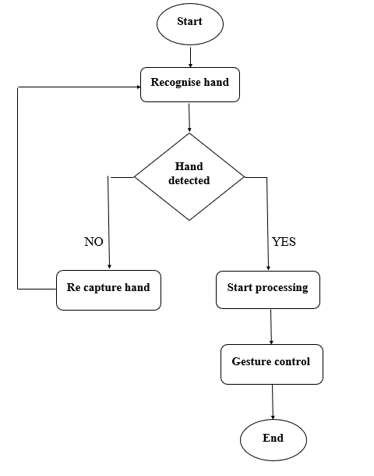
Flow Chart

Slide 11
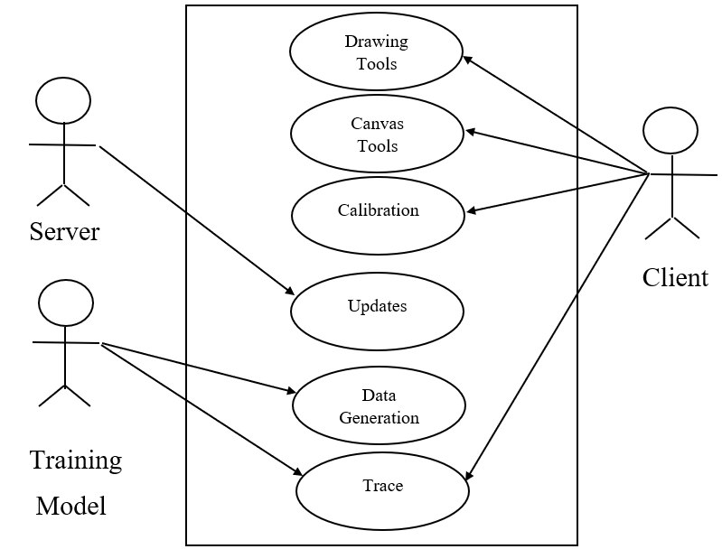
Use case diagram

Slide 12
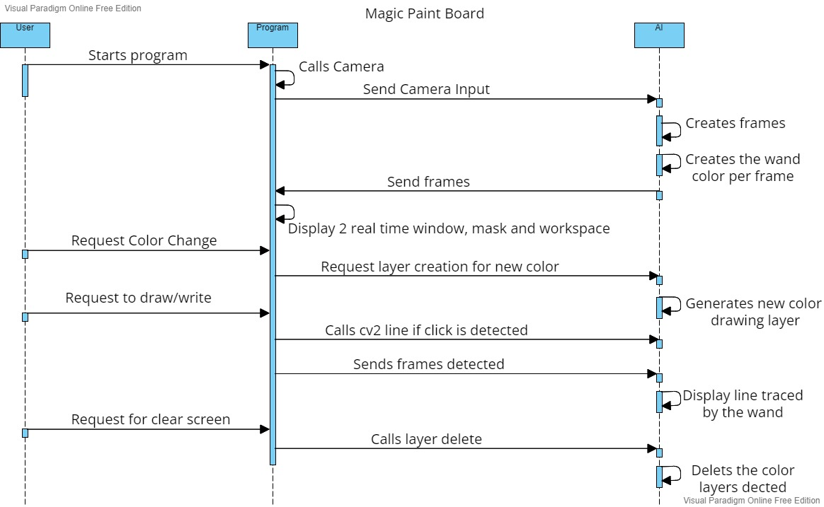
Sequence Diagram

Slide 13
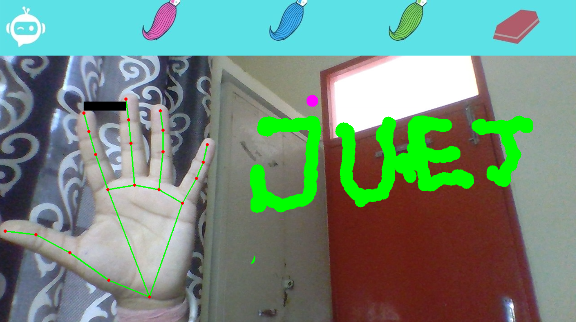
Screenshot
Hand Detection:
Hands are detected using AI

Slide 14
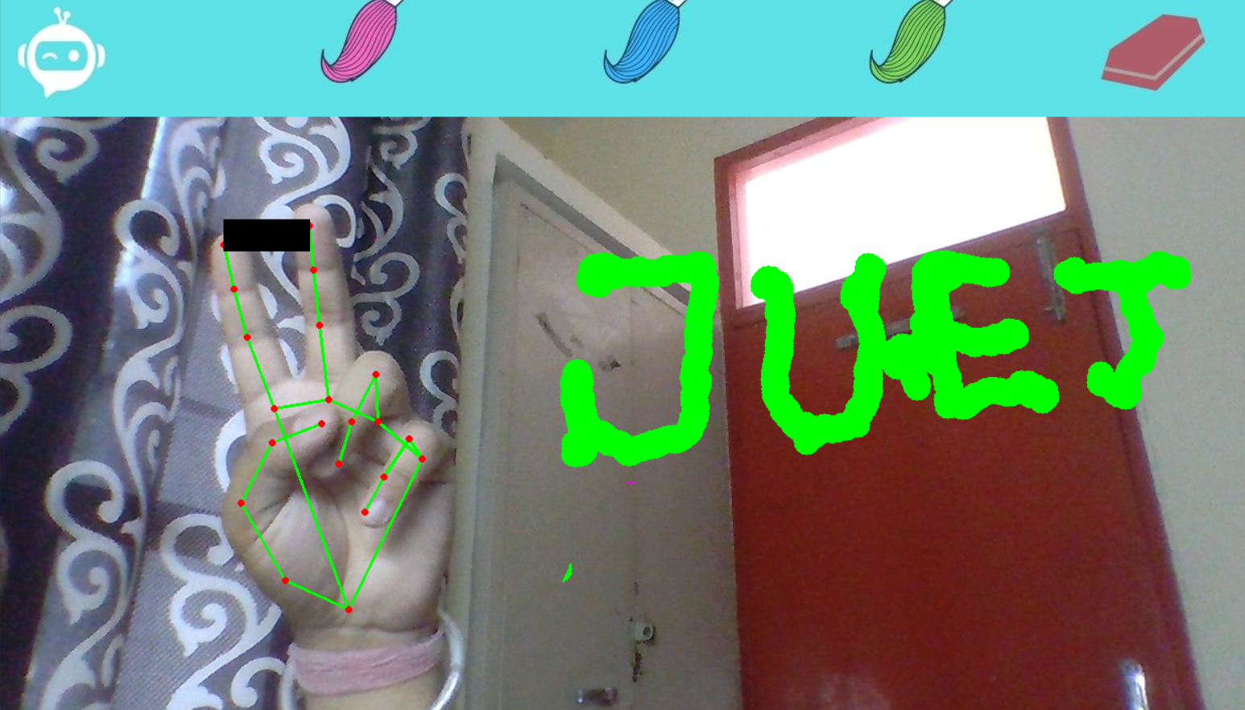
Screenshot
Selection tool using hand detection :
Two fingers are used to select the tools.

Slide 15
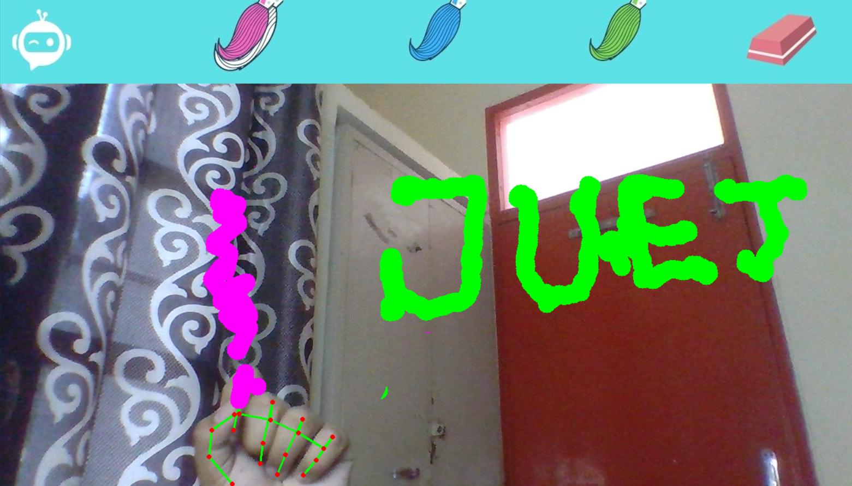
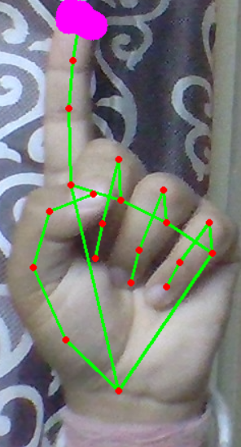
Screenshot
Drawing:
After selection of tool, user can draw with any thing on board using any fingure\thumb.

Slide 16
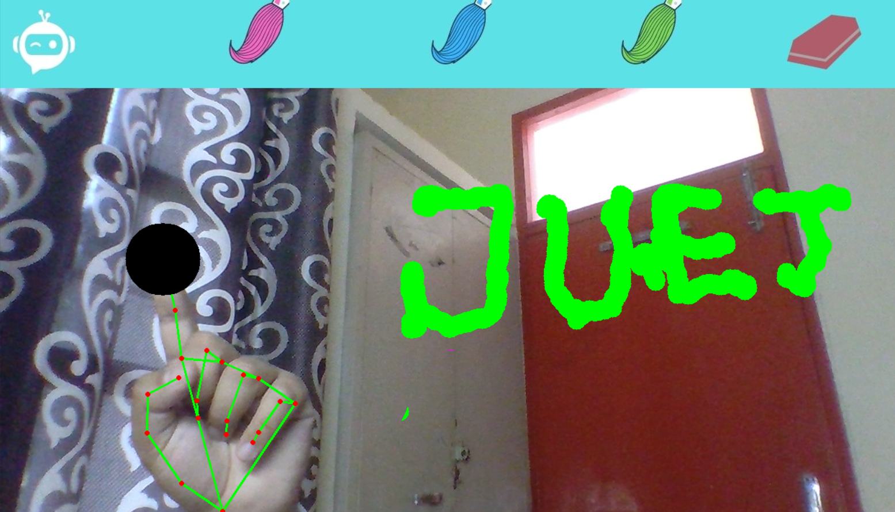
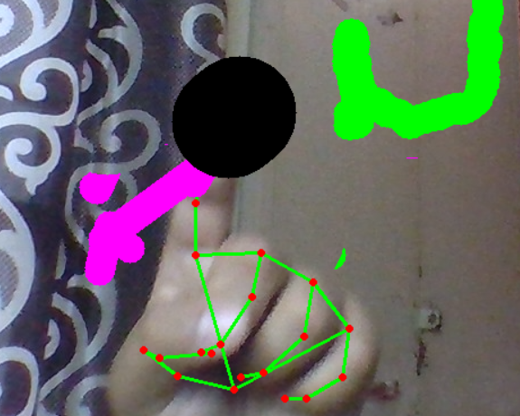
Screenshot
Eraser Tool:
Using a tool mentioned above, user can use eraser to erase any painted thing on board.

Slide 17
Conclusion
A simple, easy, optimized, smooth running software which is an alternative of hand drawings and gestures.
Which can write /paint any thing on screen virtually.

Slide 18
References
Researchers Explore Machine Learning Calibration
By PureAI Editors | March 2021 - https://pureai.com/articles/2021/03/03/ml-calibration.aspx
Distance Formula & Training for Tracing Ping Pong AI
By GitHub | March 2021 - https://github.com/AProjectAMonth/Ping-Pong
Object detection with TensorFlow model and OpenCV
By Gabriel Cassimiro | Jul 2016 - https://towardsdatascience.com/object-detection-with-tensorflow-model-and-opencv-d839f3e42849

Slide 19
Thank You

